Slide 1
Phylodynamics for recombining pathogens
Inferring phylogenetic networks
Nicola Felix Müller, PhD
e-mail: nicola.mueller@ucsf.edu

Slide 15
Our data: We know who was infected with which pathogen and sequence and when they were sampled

Slide 16
Phylogenetics allows us to infer the shared ancestral history of the different pathogens

Slide 17
Phylogenetic trees are formed by population processes and contain information about them
Notes:
The principle of tree priors is the following. Here, I show three different trees that were simulated under different models. On the left-hand side, I had a constant number of infected individuals over time. In the middle, I show a tree where the number of infected individuals was growing exponentially over time, and on the right-hand side where there was population structure, for example, caused by an infectious disease being spread between different locations.
What you can see is the branching patterns look very different between the different scenarios. For example, in the middle, we have a lot more branching or coalescent events in the past
Tree priors allow us

Slide 18
Bayesian phylogenetics allows us to jointly infer the phylogenetic trees, evolutionary and Demographics models
L. Du Plessis, T. Stadler “Getting to the root of epidemic spread with phylodynamic analysis of genomic data” Trends in Microbiology, 2015
Notes:
One way to do so, is what’s called Bayesian phylogenetics.
In Bayesian phylogenetics, we try to infer the phylogenetic tree, how genomes evolve over time, which is this second bit here and how the tree was created.
The tree generating process is some model that describes how the tree came to be.
The three terms in the back are priors that allow us to input our prior belief in parameters, for example what is a priori by expectation of the rate of evolution of a pathogen.
Back to tree priors

Slide 19
Bayesian phylogenetics allows us to jointly infer the phylogenetic trees, evolutionary and Demographics models
Tree generating models
Model of sequence evolution
L. Du Plessis, T. Stadler “Getting to the root of epidemic spread with phylodynamic analysis of genomic data” Trends in Microbiology, 2015
Notes:
One way to do so, is what’s called Bayesian phylogenetics.
In Bayesian phylogenetics, we try to infer the phylogenetic tree, how genomes evolve over time, which is this second bit here and how the tree was created.
The tree generating process is some model that describes how the tree came to be.
The three terms in the back are priors that allow us to input our prior belief in parameters, for example what is a priori by expectation of the rate of evolution of a pathogen.
Back to tree priors

Slide 20
Bayesian phylogenetics allows us to jointly infer the phylogenetic trees, evolutionary and Demographics models
Tree generating models
Model of sequence evolution
L. Du Plessis, T. Stadler “Getting to the root of epidemic spread with phylodynamic analysis of genomic data” Trends in Microbiology, 2015
Notes:
One way to do so, is what’s called Bayesian phylogenetics.
In Bayesian phylogenetics, we try to infer the phylogenetic tree, how genomes evolve over time, which is this second bit here and how the tree was created.
The tree generating process is some model that describes how the tree came to be.
The three terms in the back are priors that allow us to input our prior belief in parameters, for example what is a priori by expectation of the rate of evolution of a pathogen.
Back to tree priors

Slide 21
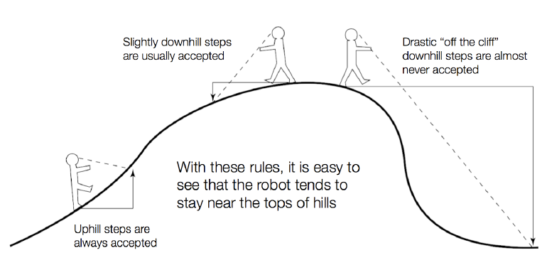
Exploring the posterior probability distribution using Markov chain Monte Carlo (MCMC)
Slide from Paul Lewis

Slide 34
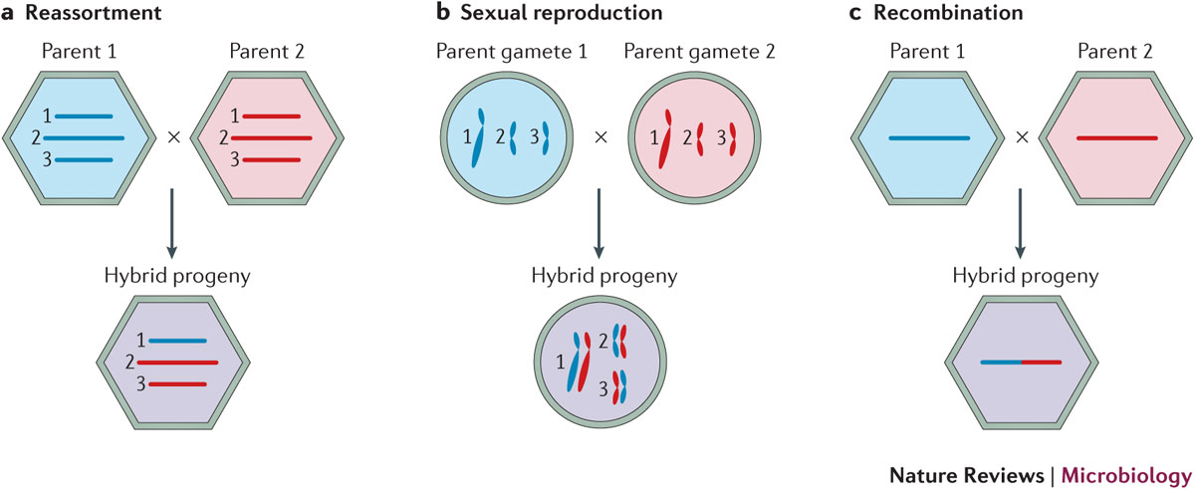
Different processes to “mix” genetic materials from two parent lineages exist

Slide 35
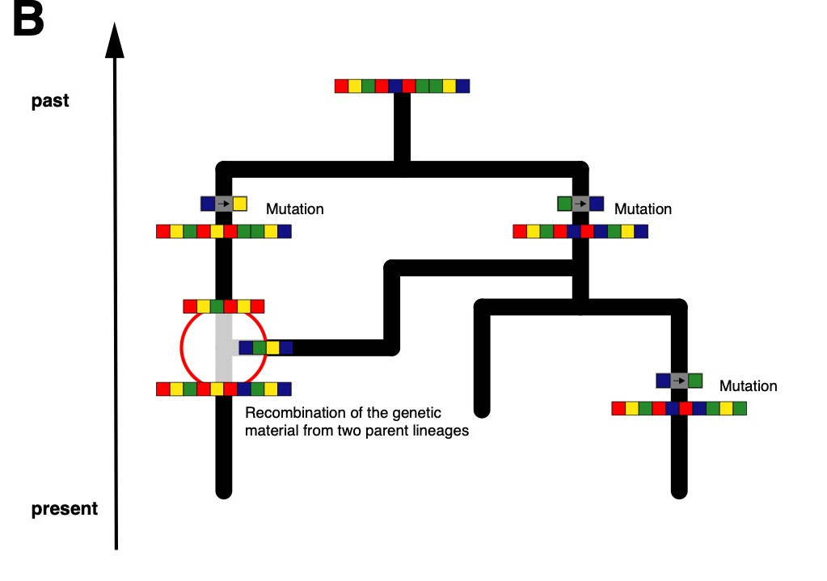
The combined genetic material may represent a network and not a tree

Slide 36
Genetic recombination processes lead to different parts of a genome coding for different histories

Slide 37
Ways to deal with recombination
Only use small parts of the genome that code for the same tree (e.g. only use one segment of influenza).
Consider different parts of a genome to be independent (Bad if they are not).
Just ignore recombination (bad if there is).
Infer networks instead of trees. (Best case, but potentially slow)

Slide 38
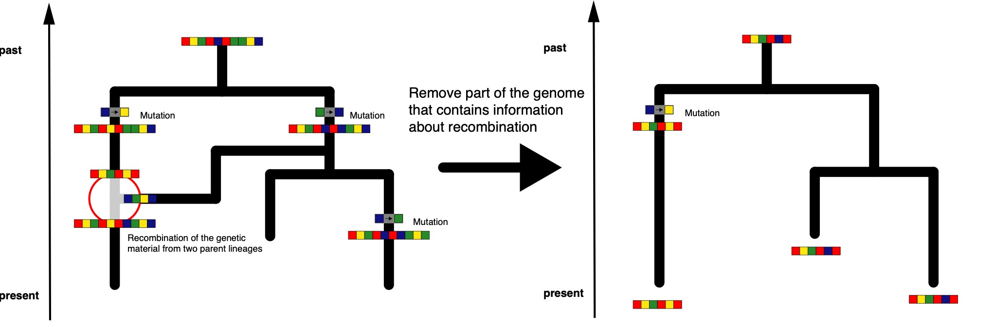
Only use small parts of the genome that code for the same tree.

Slide 39
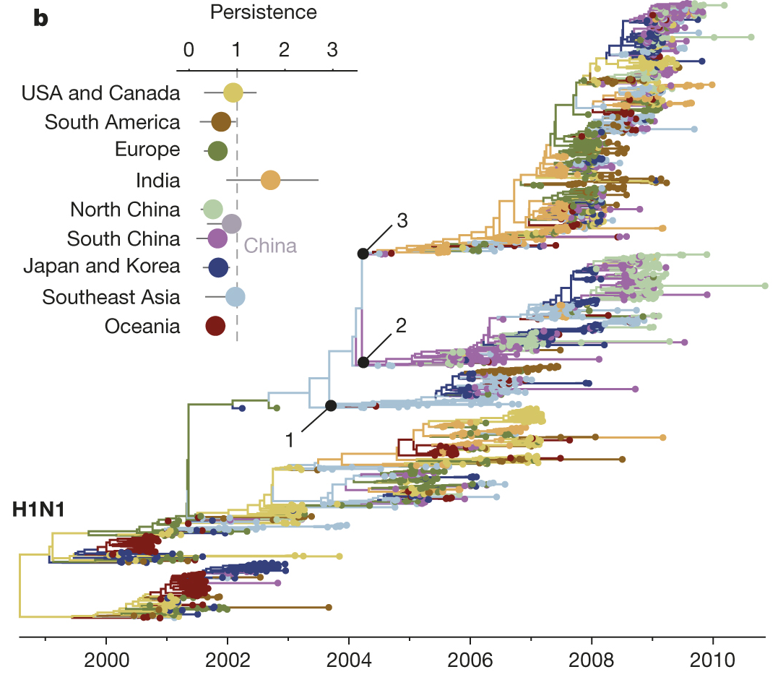
Population dynamics can be inferred from individual influenza segments
Bedford et al., 2015, Nature

Slide 40
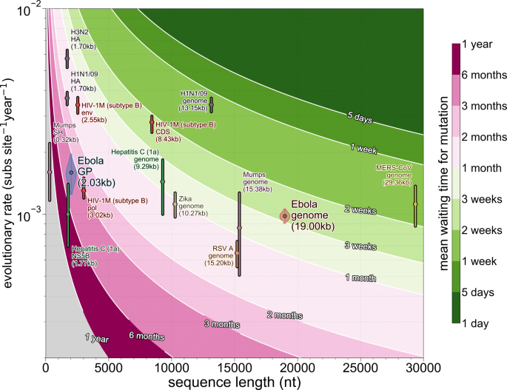
Using only part of pathogen genomes reduces time resolution
Dudas et al., 2019, BMC Eco. Evo.

Slide 41
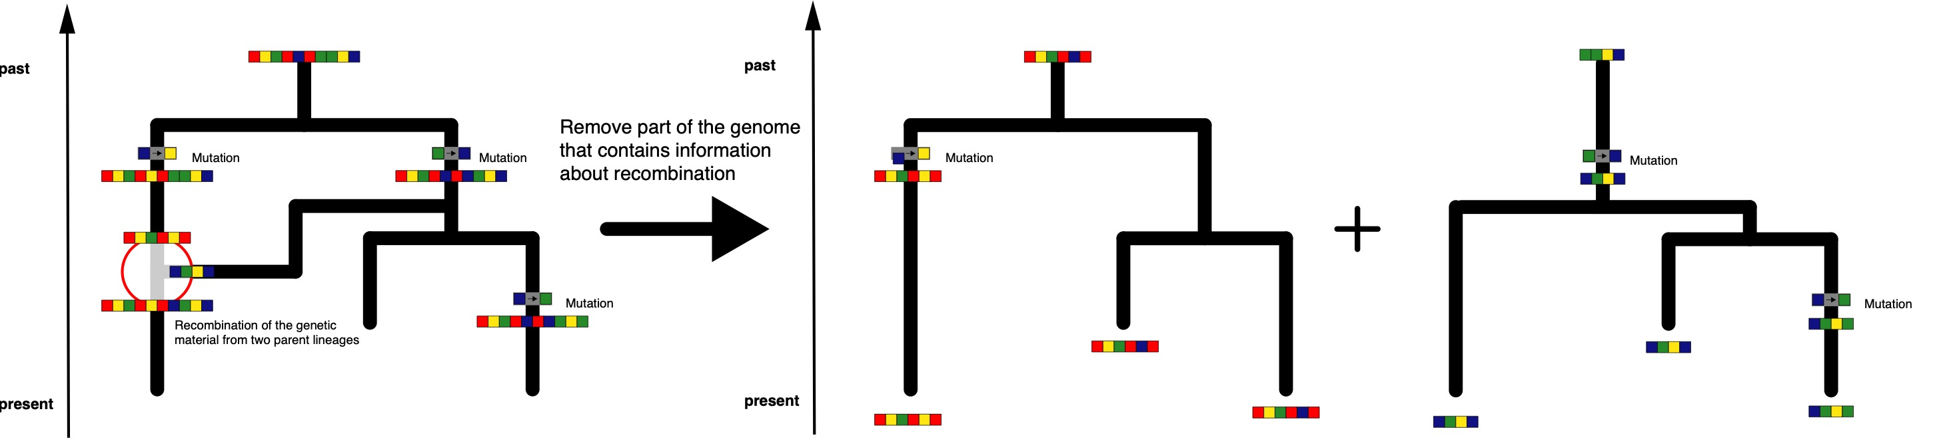
Consider different parts of a genome to be independent. (Sometimes correct)

Slide 42
Species tree inferences typically assume individual parts of the genome to be independent observations of a speciation process

Slide 43
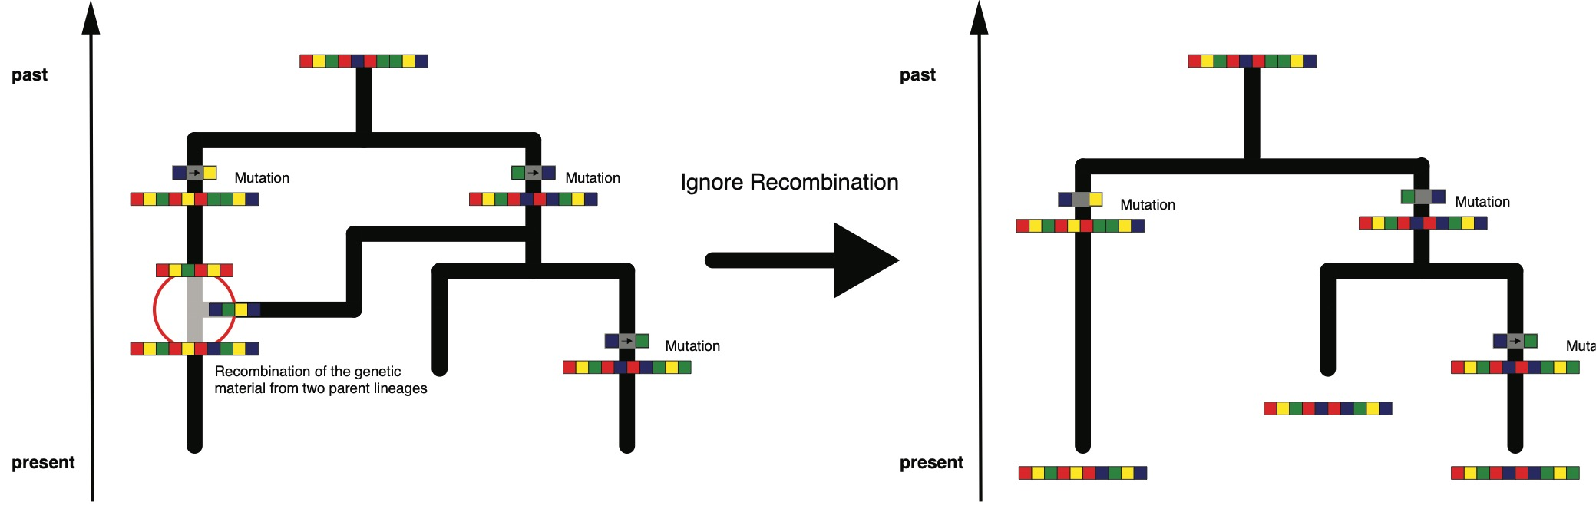
Just ignore recombination. (Always wrong)

Slide 44
QUESTIONS?

Slide 45
To perform inference of phylogenetic networks, we have to introduce a new inference approach
Notes:
To be able to infer reassortment networks, we have to be able to characterize the posterior distribution of reassortment networks, evolution

Slide 46
To infer phylogenetic networks, we need the following
A way to explore the posterior probability

Slide 47
To infer phylogenetic networks, we need the following
A way to explore the posterior probability
The network likelihood can be expressed as a product of tree likelihoods on the different nucleotide positions

Slide 48
To infer phylogenetic networks, we need the following
A way to explore the posterior probability
The network likelihood can be expressed as a product of tree likelihoods on the different nucleotide positions
The network prior requires a network generating model, such as a coalescent process

Slide 49
To explore of phylogenetic networks, we need to “operate” on the networks
Müller et al. (2020), PNAS

Slide 50

can be expressed as the product of tree likelihoods
The probability of observing each position in this alignment only requires knowing the tree at this position.
Therefore = $\prod^{sites}{}$

Slide 51
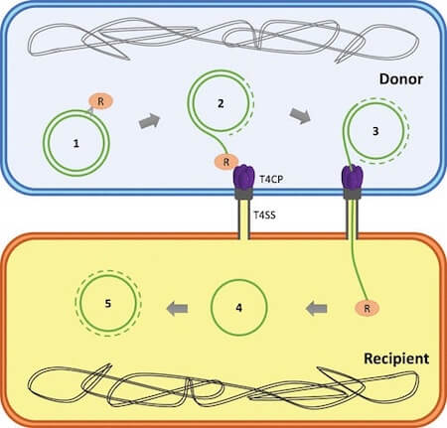
models as a coalescent and reassortment/recombination/plasmid transfer process
E. Simon-Loriere, E. C. Holmes “Why do RNA viruses recombine?” Nature Reviews Microbiology, 2011
Getting et al./Microbiology Spectrum, Jan. 2018
Notes:
15 mins

Slide 52
models as a coalescent and reassortment/recombination/plasmid transfer process
E. Simon-Loriere, E. C. Holmes “Why do RNA viruses recombine?” Nature Reviews Microbiology, 2011
Getting et al./Microbiology Spectrum, Jan. 2018

Slide 53
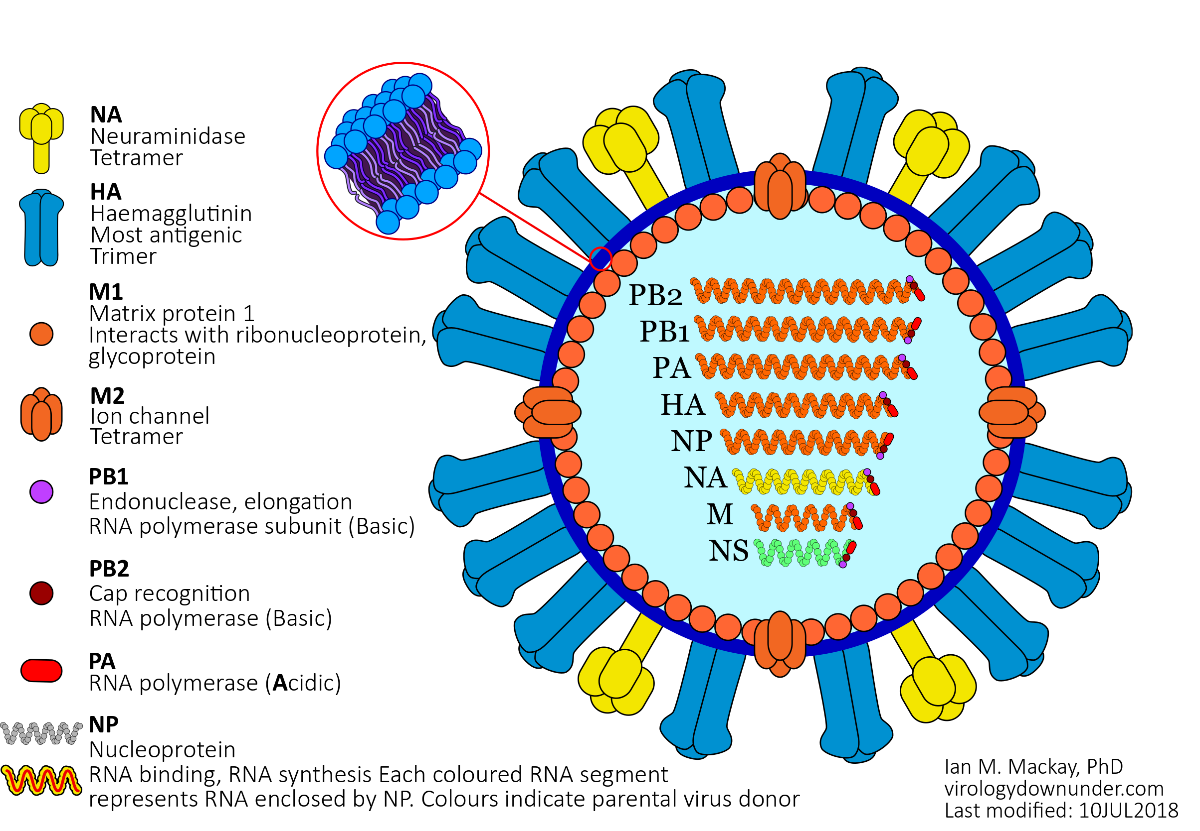
The genome of Influenza in organized in several separated segments
Mackay, I. M.. Influenza virus. (2018). doi:10.6084/m9.figshare.6817112.v1
Notes:
Genome of influenza is build up by several spatially separated segments.
Each segment code for one or more Proteins.
Proteins have different functions, HA NA antigens, cell binding.

Slide 54
Reassortment leads to a reshuffling of segments from different ancestral lineages
E. Simon-Loriere, E. C. Holmes “Why do RNA viruses recombine?” Nature Reviews Microbiology, 2011
Notes:
One of the processes that can mix genetic material from different parental lineages is called reassortment.
The genome of influenza viruses is organized in separate segments
Upon co-infection of a cell, the cell starts producing new influenza viruses.
But the genomic segments of these viruses can originate from either parental lineage, allowing for new combinations of segments to emerge

Slide 55
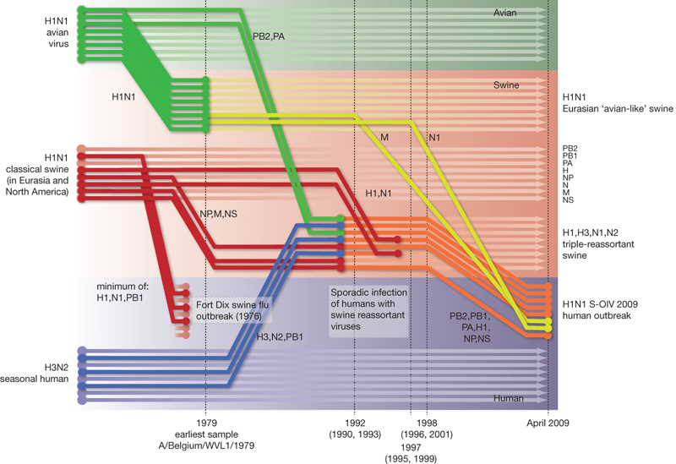
Reassortment between subtypes can create progenitors with segments that originate from different parents
Smith, G., Vijaykrishna, D., Bahl, J. et al “Origins and evolutionary genomics of the 2009 swine-origin H1N1 influenza A epidemic” Nature, 2009
Notes:
Between different subtypes, this process can play an important role in generating novel influenza variants
Example 2009 influenza A/H1N1 pandemic
PB1 from human H3N2
HA, NP and NS from swine viruses descended from p1918 like H1N1
Reassortment allows viruses to make big jumps

Slide 56
Three samples of a hypothetical influenza virus with three segments

Slide 57
Going back in time, two lineages can share a common ancestor at a rate inverse proportional to Ne

Slide 58
A lineage can reassort at a rate given by the reassortment rate with each segment having originated from one parental lineage

Slide 59
More lineage share a common ancestor

Slide 60
Until all lineage coalescence at the root of the phylogenetic network

Slide 61
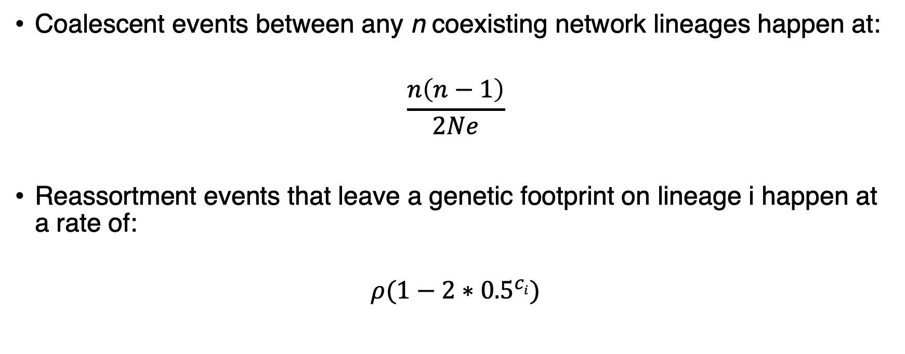
The coalescent with reassortment models a joint coalescent and reassortment process
Coalescent events between any n coexisting network lineages happen at:
$$\frac{n\left(n−1\right)}{2Ne}$$
Reassortment events that leave a genetic footprint on lineage i happen at a rate of:
$$ρ(1−{2∗0.5}^{ci})$$

Slide 62
The reassortment rate is a backwards in time rate of observing reassortment events
The reassortment rate is a function of:
The probability that co-infection occurs
The probability of reassortment in a co-infected individual
The success/selection of reassortants

Slide 63
Bayesian inference allows us to infer the posterior distributions of:
Reassortment networks
The embedding of segment trees in those networks
The parameters of evolution of the different segments
Demographic parameters and rates of reassortment

Slide 64
Bayesian inference allows us to infer the posterior distributions of:
Reassortment networks
The embedding of segment trees in those networks
The parameters of evolution of the different segments
Demographic parameters and rates of reassortment

Slide 65
Bayesian inference allows us to infer the posterior distributions of:
Reassortment networks
The embedding of segment trees in those networks
The parameters of evolution of the different segments
Demographic parameters and rates of reassortment

Slide 66
Bayesian inference allows us to infer the posterior distributions of:
Reassortment networks
The embedding of segment trees in those networks
The parameters of evolution of the different segments
Demographic parameters and rates of reassortment

Slide 67
CoalRe allows inferring reassortment networks, reassortment rates etc. jointly
Müller et al. (2020), PNAS

Slide 68
Correctly modelling the reassortment process impact precision and reduces bias
Müller et al. (2020), PNAS

Slide 69
Explicitly modeling when and where reassortment events occurred allows us to investigate whether there are patterns
Müller et al. (2020), PNAS
Notes:
Since we infer actual networks, we can also check to see if there are particular parts of these networks where reassortment rates are elevated.
What we find is that for most human influenza viruses, there is evidence that reassortment events occur more often on lineages that are more likely to persist for a long time, suggesting a fitness benefit to reassortment

Slide 70
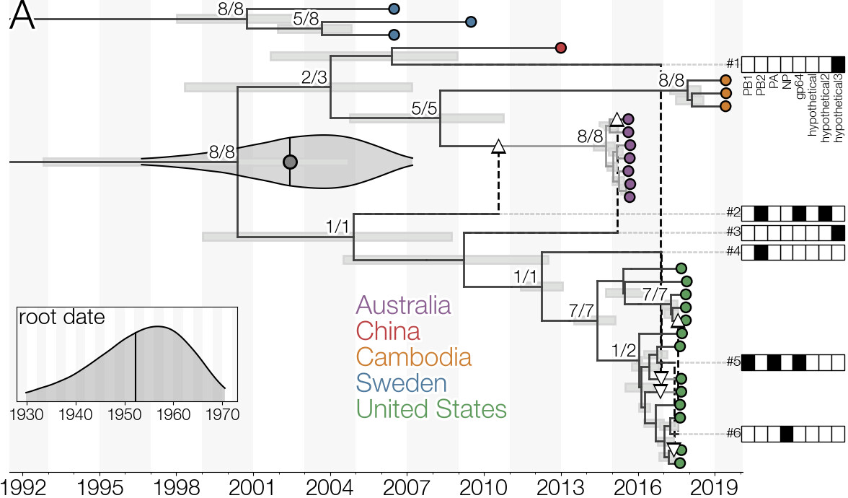
CoalRe to track the movement and evolution of orthomyxoviruses
Dudas et al. (2020), J Virol
Notes:
Since we infer actual networks, we can also check to see if there are particular parts of these networks where reassortment rates are elevated.
What we find is that for most human influenza viruses, there is evidence that reassortment events occur more often on lineages that are more likely to persist for a long time, suggesting a fitness benefit to reassortment

Slide 71
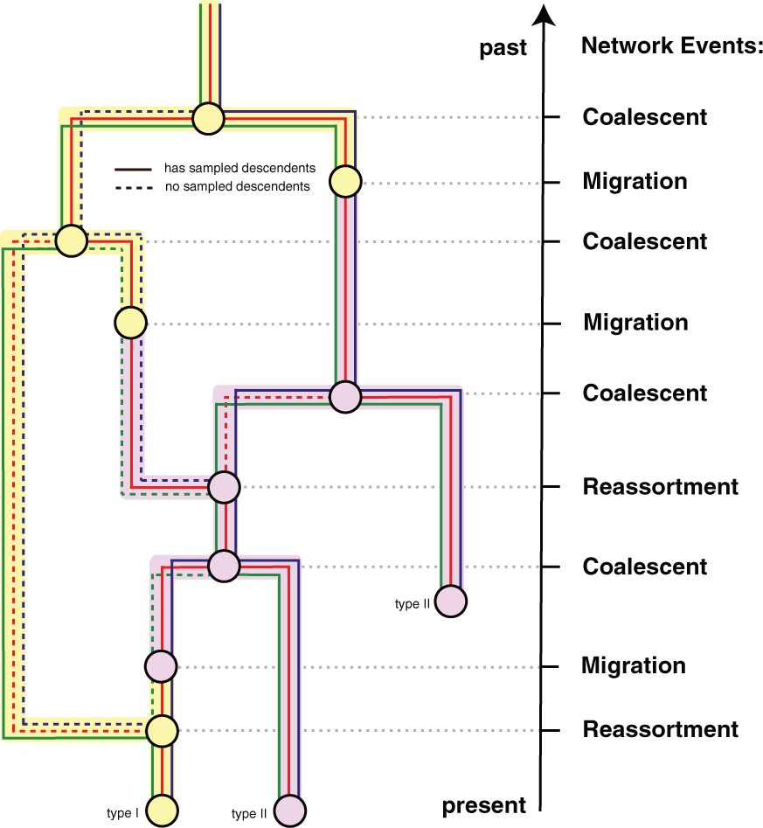
Reassortment and population structure can be reconstructed jointly
Stolz et al. (2021), Mol. Biol. Evol.

Slide 72
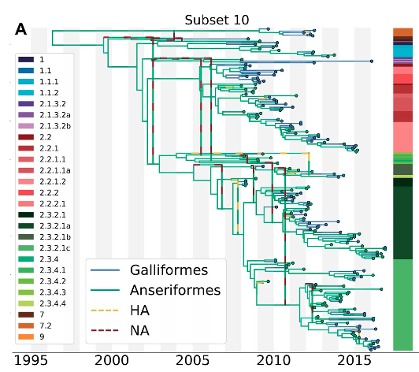
The structured coalescent with reassortment can be used to reconstruct where and when reassortment occurred.
Stolz et al. (2021), Mol. Biol. Evol.

Slide 73
models as a coalescent and reassortment/recombination/plasmid transfer process
E. Simon-Loriere, E. C. Holmes “Why do RNA viruses recombine?” Nature Reviews Microbiology, 2011
Getting et al./Microbiology Spectrum, Jan. 2018
Notes:
27 mins

Slide 74
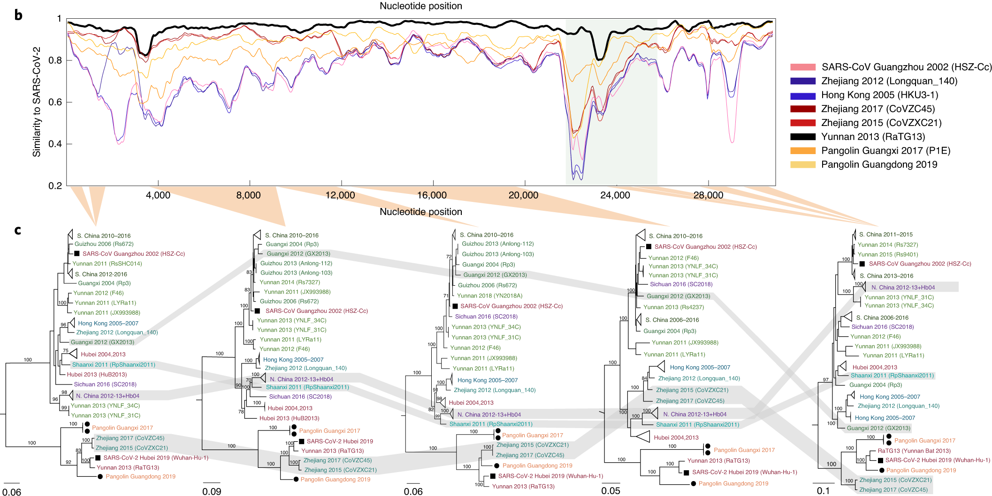
Different parts of the genome of SARS-like viruses code for different ”trees”
Boni et al. (2020), Nat. Mic.
Notes:
Some RNA viruses, including coronaviruses, can recombine in a process called template switching.
Viruses produced in this process can carry information about different evolutionary histories and therefore phylogenetic trees on different parts of the genome.
As soon as there is recombination in my sequence alignment, this also means that I can no longer use the standard toolbox of phylogenetic and phylodynamic methods to study, for example, SARS-CoV-2.
This means that we again need some model to account for this process.

Slide 75
To switch to networks, we conceptually just replace the tree terms with networks

Slide 76
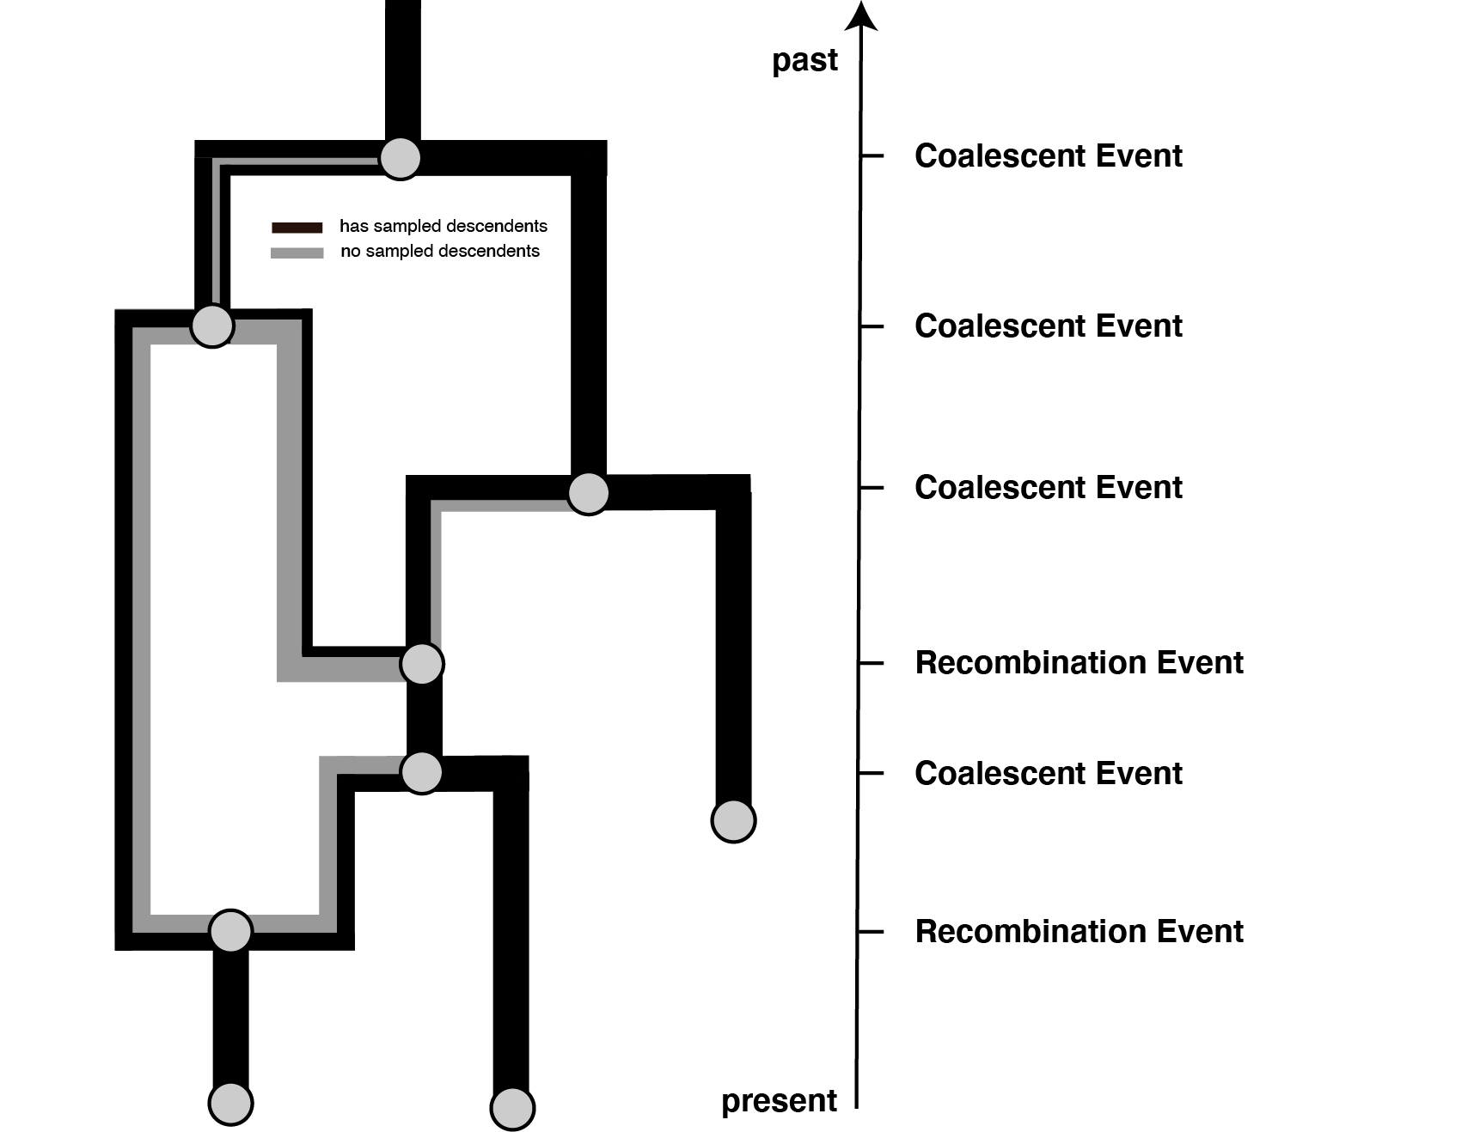
The complex recombination process can be simplified and modeled as a joint coalescence and recombination process.
Müller et al. (2022), Nat. Comm.
Notes:
We again need three things.
We need to allow for sampling events, that is pathogens being isolated and sequenced.
We need to allow for coalescent events that denote when two pathogens last shared a common ancestor
And we need to allow for recombination events where one one side of a recombination breakpoint, the genome codes for one evolutionary history and on the other side for another history.
Using this simple coalescent with recombination model, alongside a quite complex Bayesian inference framework, allows us to infer recombination networks of coronaviruses.

Slide 77
Recombination events can be inferred well, but getting actual posterior support values is hard
Müller et al. (2022), Nat. Comm.

Slide 78
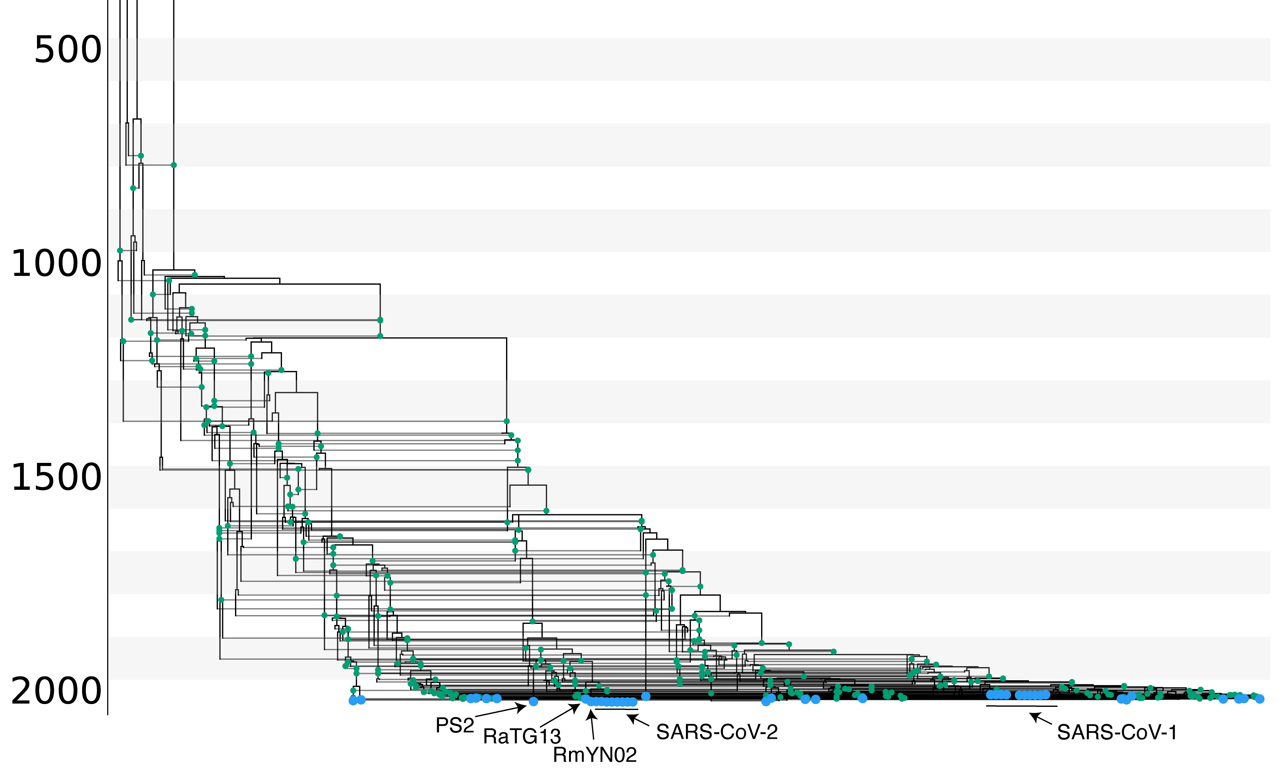
Recombination events shaped the evolutionary history of SARS-like viruses.
Müller et al. (2022), Nat. Comm.
Notes:
We can then use the coalescent with recombination to infer the evolutionary history of SARS-like viruses.
Each vertical line and green dot denotes a different recombination event.
What we can see here is that recombination plays an crucial role in shaping the evolution of SARS-like viruses.
In what way exactly is unclear, but there are definitely a lot of those recombination events.
We can also use this approach to study which are the closest relatives or SARS-CoV-2 that were sequenced.
While RaTG13 in pink is the closest relative to SARS-CoV-2 in terms of sequence identity, RmYN02 in orange shares the most recent common ancestor with SARS-CoV-2.
While recombination shapes the evolution of these viruses in the animal reservoir, we can next check whether this is the case in other host as well.

Slide 79
Evidence for a few recombination events in the recent history of SARS-CoV-2 before entering the human population
Müller et al. (2022), Nat. Comm.

Slide 80
Recombination events shaped the evolutionary history of SARS-like viruses.
Müller et al. (2022), Nat. Comm.

Slide 81
The analyzed SARS-like dataset contains about 300 recombination events, meaning the average number of consecutive basepairs that code for the same tree is 100
Müller et al. (2022), Nat. Comm.

Slide 82
RmYN02 is the closest common ancestor to SARS-CoV-2 on most parts of the genome.
Müller et al. (2022), Nat. Comm.

Slide 83
Notes:
To do so, we reconstructed the recombination networks of 4 other coronaviruses.
Mers, where the main host are camel with occasional spill over into humans and 3 seasonal human covoronaviruses, 229e, oc42 and nl63.
We can see that recombination shapes the evolutionary history of these viruses.
In fact, if we look at these rates of recombination, we find that they are quite comparable to reassortment rates in influenza viruses.

Slide 84
Recombination rates vary with rates of adaptation across the genomes of seasonal coronaviruses
Müller et al. (2022), Nat. Comm.

Slide 85
models as a coalescent and reassortment/recombination/plasmid transfer process
E. Simon-Loriere, E. C. Holmes “Why do RNA viruses recombine?” Nature Reviews Microbiology, 2011
Getting et al./Microbiology Spectrum, Jan. 2018
Notes:
35 mins

Slide 86
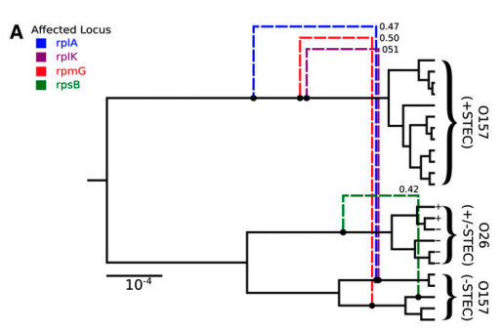
Ancestral recombination graphs for the coalescent with gene conversion can be inferred in BEAST2 using Bacter
Allows to estimate tree based networks that have a base tree and edges that detach and re-attach directly to that base tree
Requires the assumption that only a small part of the genome is subject to recombination
Vaughan et al. (2017), Genetics

Slide 87
The transfer of plasmids between bacterial lineages can be inferred using phylogenetic networks
Müller et al. (2023), BioRxiv
Notes:
38 mins

Slide 88
The transfer of plasmids between bacterial lineages can be inferred using phylogenetic networks
Müller et al. (2023), BioRxiv
Notes:
38 mins

Slide 89
The transfer of plasmids between bacterial lineages can be inferred using phylogenetic networks
Müller et al. (2023), BioRxiv
Notes:
38 mins

Slide 90
spA is transferred between lineages more often than other plasmids with unknown function (spB, spC) and the much larger virulence plasmid
Müller et al. (2023), BioRxiv

Slide 91
The transfer of plasmids between bacterial lineages can be inferred using phylogenetic networks
Müller et al. (2023), BioRxiv
Notes:
38 mins

Slide 92
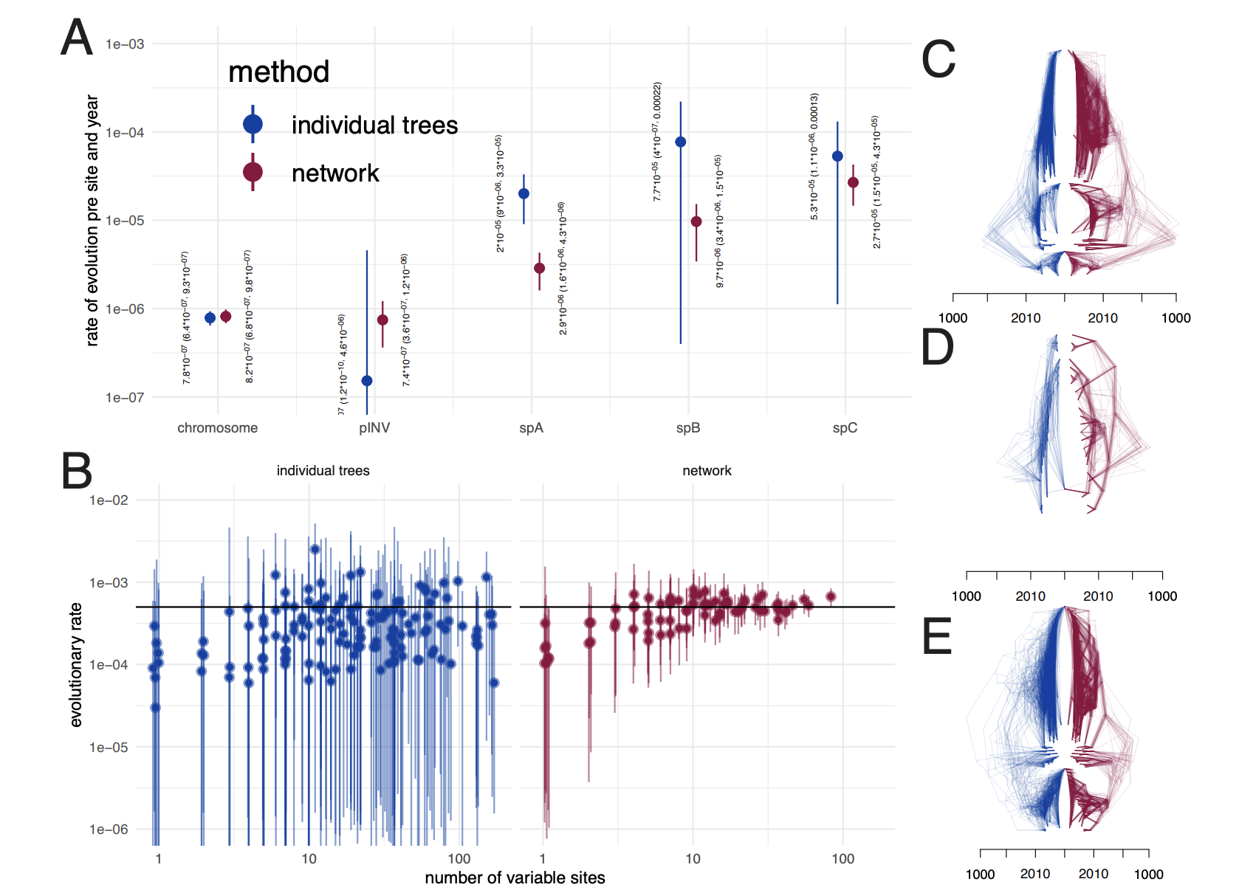
Modelling the co-evolution of plasmids and chromosome improves resolution of plasmids
Müller et al. (2023), BioRxiv
Notes:
38 mins

Slide 93
The ancestral history of pKSR100 shows multiple jumps between bacterial lineages of S. sonnei and S. flexneri
S. flexneri
S. sonei
Müller et al. (2023), BioRxiv

Slide 94
Reconstructing the co-evolutionary history of the core chromosome and plasmid allows mapping host switches onto the plasmid tree
Müller et al. (2023), BioRxiv

Slide 95
Expansion of pSKR100 in the last decade
N. F. Müller, Sebastián Duchêne, Deborah A. Williamson, Benjamin Howden, Danielle J Ingle “Tracking the horizontal transfer of plasmids in Shigella sonnei and Shigella flexneri using phylogenetics” BioRxiv, 2022

Slide 96
QUESTIONS?

Slide 97
Some reading material
Coalescent with recombination: https://doi.org/10.1016/0040-5809(83)90013-8
Coalescent with gene conversion: https://www.genetics.org/content/155/1/451.short
ARG’s for bacteria: https://www.genetics.org/content/205/2/857
Coalescent with reassortment: https://www.pnas.org/content/early/2020/07/02/1918304117

